Slide 1

Synthetic Customer Profiles for Product Recommendation
Institute: Global Next Consulting India Pvt. Ltd.
Mentor: Abhipsa Guha
Group:1
Team Members: Aditi, Disha, Aryan, Himanshu, Lakshya

Slide 2
Content
01
Introduction
Slide 03
07
Algorithm Used
Slide 09
02
Problem Statement
Slide 04
08
EDA & Visualization
Slide 10
03
Objective
Slide 05
09
Results And Performance
Slide 15
04
Workflow
Slide 06
10
Innovation
Slide 16
05
Tool & Model
Slide 07
11
Conclusion
Slide 17
06
Methodology
Slide 08
12
Team Roles
Slide 18
Cognisynth

Slide 3
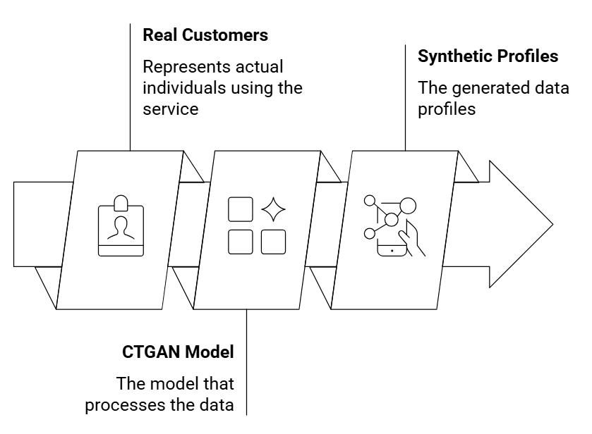
Synthetic customer profiles are artificially generated but realistic data points.
This lets companies build and test product recommendation systems safely, even when real data is limited or private.
Using synthetic data helps solve problems like data shortages, privacy rules, and unbalanced datasets, making machine learning faster and more secure.
Used for building recommender systems without breaching privacy.
Our goal: To train AI models safely, accurately, and ethically using Generative AI.
Introduction
Cognisynth

Slide 4
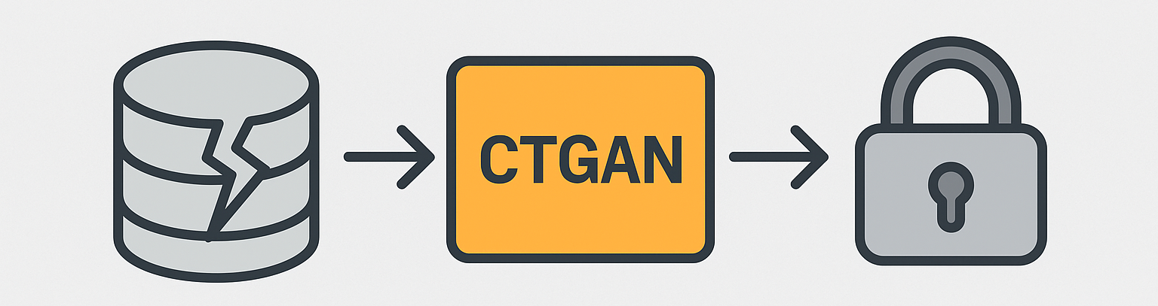
Problem Statement
Real customer data is often limited, imbalanced, or sensitive.Privacy regulations restrict access to real user information.
Incomplete or noisy data makes training recommendation models difficult.
Cognisynth

Slide 5
Objectives
Objective 1
Objective 2
Generate high-fidelity synthetic data via CTGAN.
Validate realism through EDA comparisons.
Objective 3
Objective 4
Objective 5
Train Random Forest / XGBoost / LightGBM.
Benchmark synthetic vs real performance
Deliver reusable AI pipeline for future datasets.
Cognisynth

Slide 6
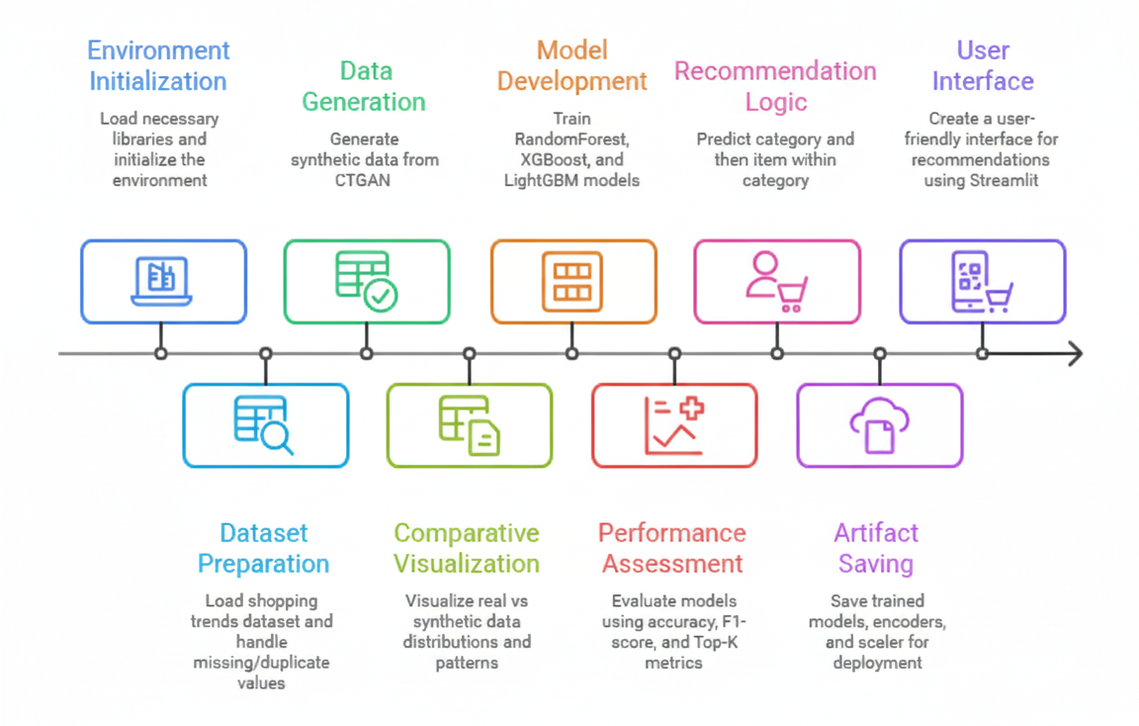
Workflow
Cognisynth

Slide 7
Tool & Models
Models
Tools
Streamlit
Matplotlib
Seaborn
Plotly
Plotly Express
Random Forest
XGBoost
LightGBM
CTGAN
Cognisynth

Slide 8
Methodology
Step | Description
1. Data Preprocessing | Clean nulls, encode categories, normalize purchase values.
2. Metadata Schema Creation | Automatically detect table schema for CTGAN using SDV.
3. Synthetic Data Generation (CTGAN) | Train for 50 epochs → Generate 3,900 synthetic samples.
4. Validation (EDA) | Compare synthetic vs real: distributions, correlations.
5. Model Training & Testing | Apply Random Forest, XGBoost, LightGBM.
6. Evaluation | Compare accuracies and visualize improvements.
Cognisynth

Slide 9




Algorithm Used
CTGAN
Random Forest
XGBoost
LightGBM
CTGAN generates synthetic tabular data that closely mimics your real dataset — including numerical and categorical features.
To create privacy-preserving synthetic customer data that maintains the same distribution and patterns as real data, useful for model training.
Predicts outcomes (e.g., product category or purchase behavior) by combining multiple decision trees.
Serves as a baseline model to test whether synthetic data performs similarly to real data.
Improves accuracy by building trees sequentially — each new tree focuses on the errors of the previous ones.
Used for high-accuracy product recommendation and purchase prediction, outperforming baseline models.
A faster and more memory-efficient alternative to XGBoost — ideal for large datasets.
To train recommendation models on both real and synthetic data quickly while maintaining accuracy.
Cognisynth

Slide 10
EDA & Visualization
01
Comparison Of Top Categories
Slide 11
02
Model Performance And Accuracy
Slide 12
03
Comparison Of Customer Age Distribution
Slide 13
04
Top Features For Categories Distribution
Slide 14
Cognisynth

Slide 11
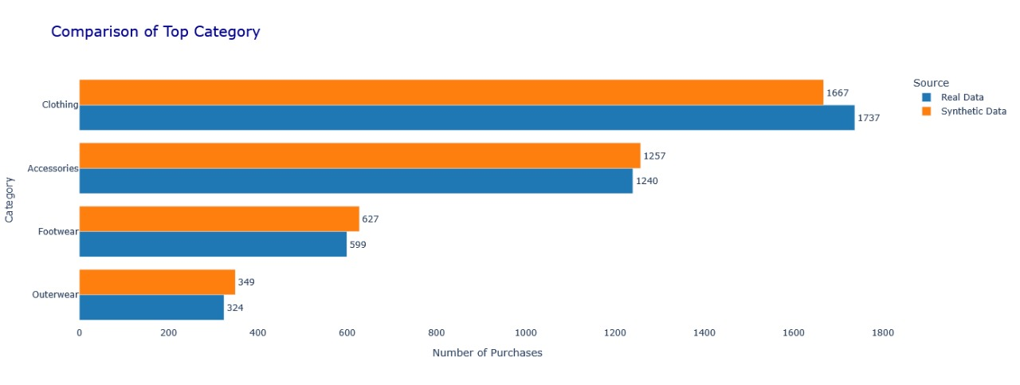
Comparison of Top Category
Cognisynth

Slide 12
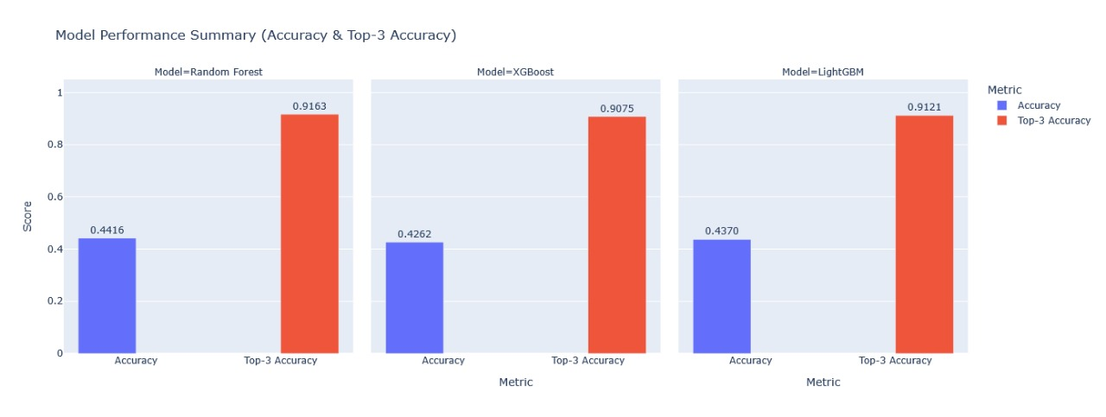
Model Performance and Accuracy
Cognisynth

Slide 13
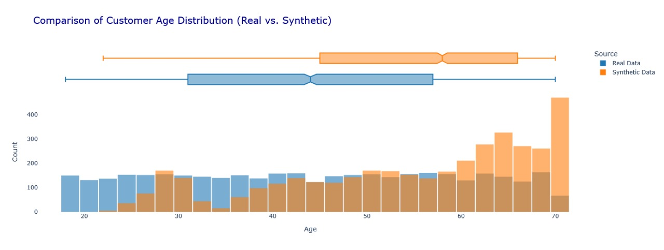
Comparison of Customer Age Distribution
Cognisynth

Slide 14
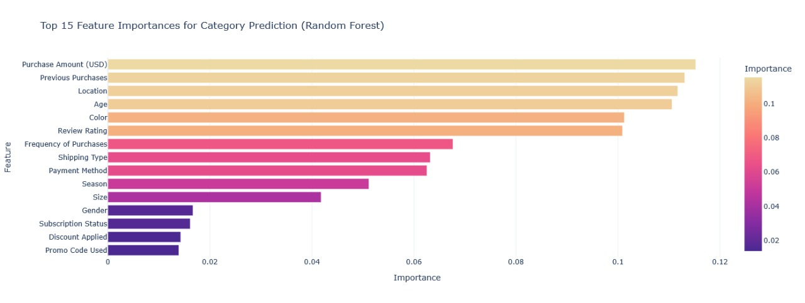
Top Features for Category Prediction (Random Forest)
Cognisynth

Slide 15
Results & Performance
Model | Accuracy | Top 3 Accuracy
Random Forest | 0.4320 | 0.9059
XGBoost | 0.4251 | 0.9038
LightGBM | 0.4362 | 0.9059
Cognisynth

Slide 16
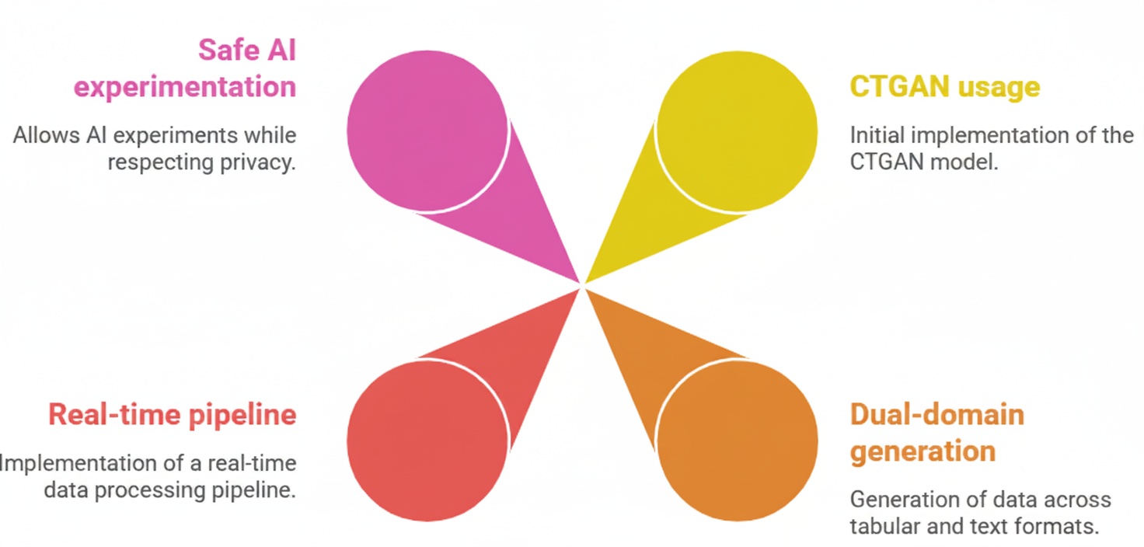
Innovation
Cognisynth

Slide 17
Conclusion
The project successfully demonstrates how Generative AI can produce realistic, privacy-preserving synthetic datasets for retail analytics.Using CTGAN and GPT-2, we created synthetic customer profiles that retained core behavioral patterns from real data. Model evaluation proved that combining synthetic and real datasets enhances recommendation accuracy while maintaining ethical and legal data compliance.
Cognisynth

Slide 18

Team Roles
ADITI
DISHA
DOCUMENTATION
EDA
MODELING
ARYAN
DEPLOYMENT
LAKSHYA
HIMANSHU
MODELING
EDA
Cognisynth

Slide 19
Thank you!
Cognisynth

